Slide 1



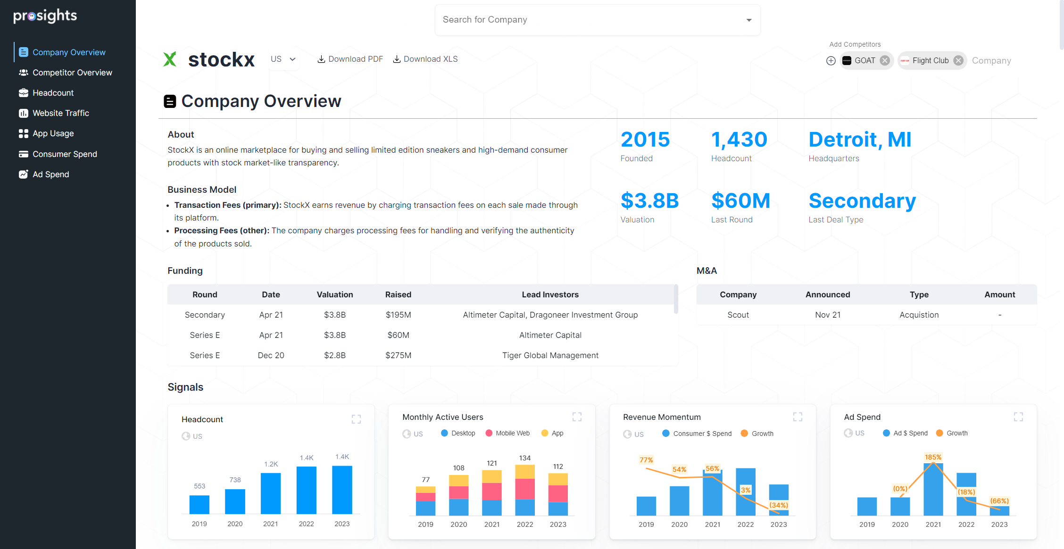
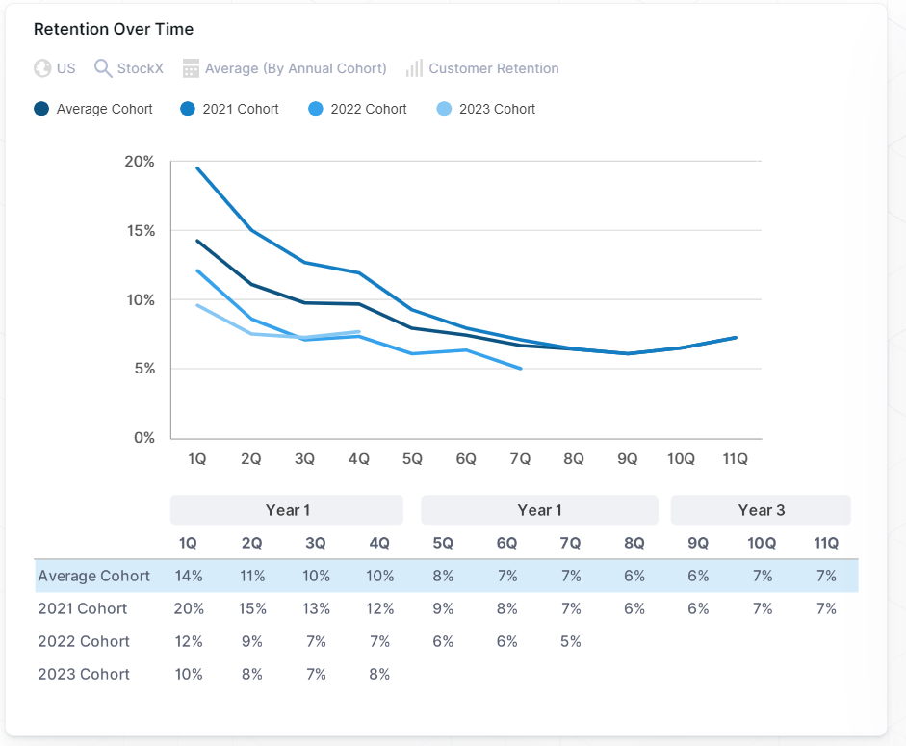

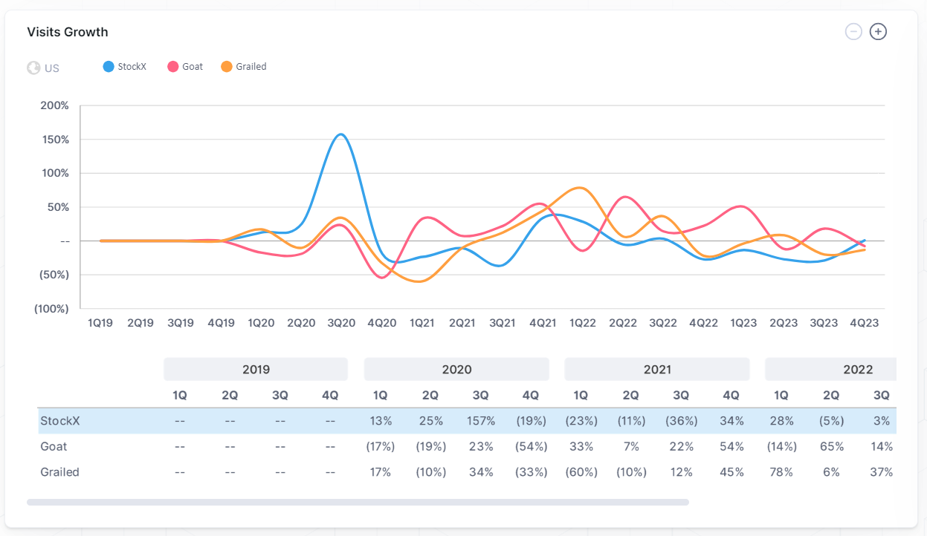

Improve deal flow with quicker and better insights.
Diligence tool for investors to quickly gain insights on any company
Aggregates and analyses 3rd party data to answer questions around company momentum and asset quality
Company Description
Fundraising
Business Model
Headcount
Website Traffic
Consumer Spend
App Usage
Ad Spend
Backed by

Slide 5
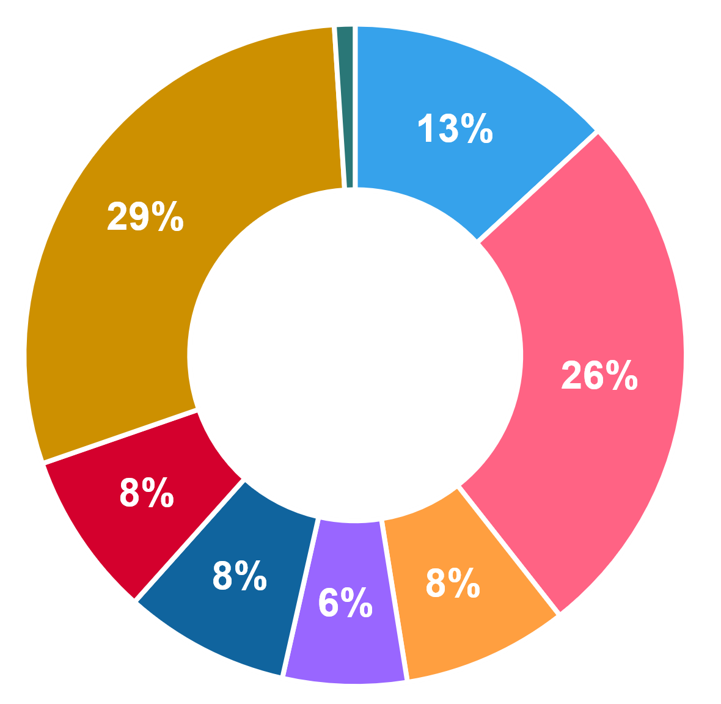
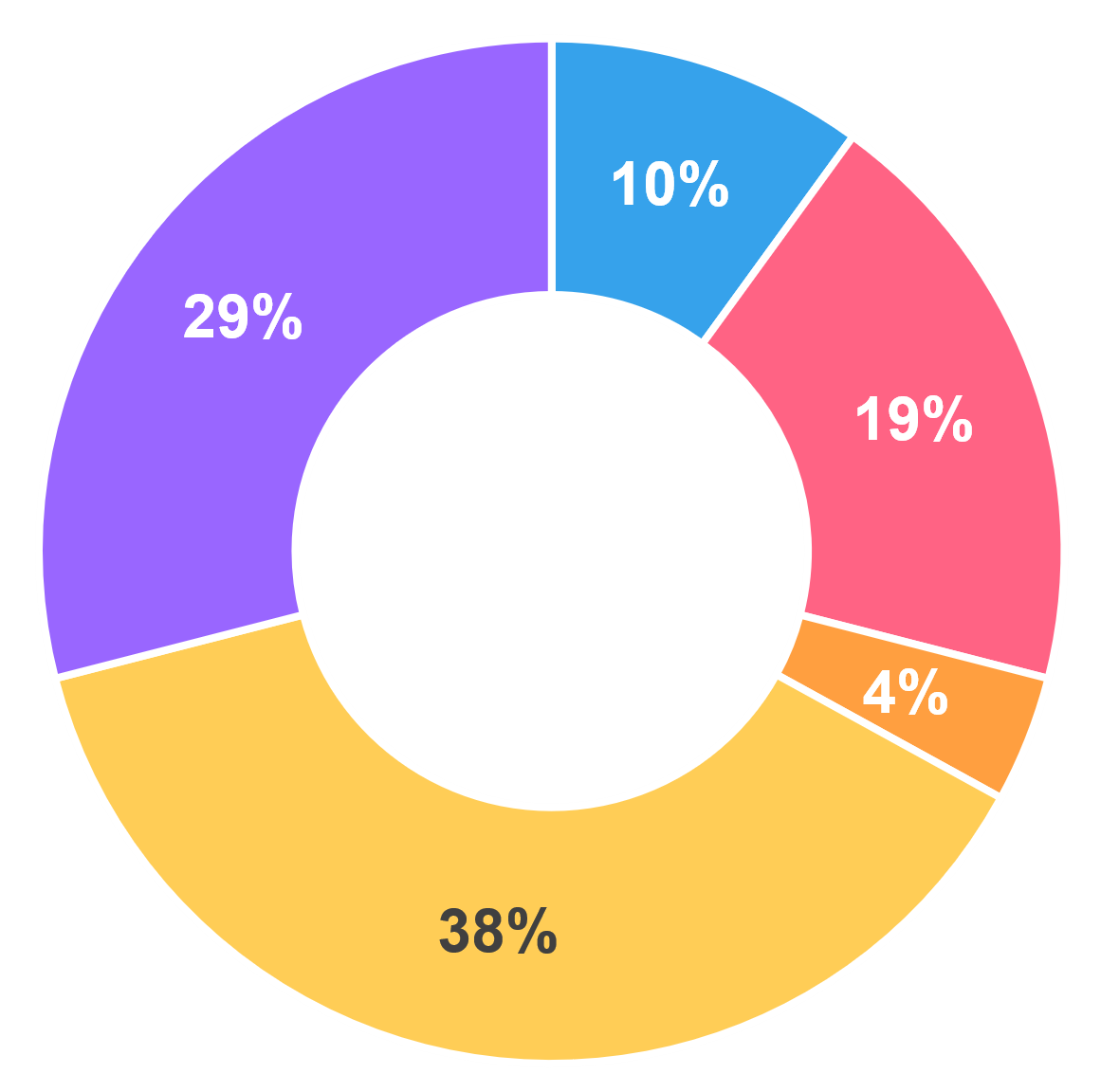
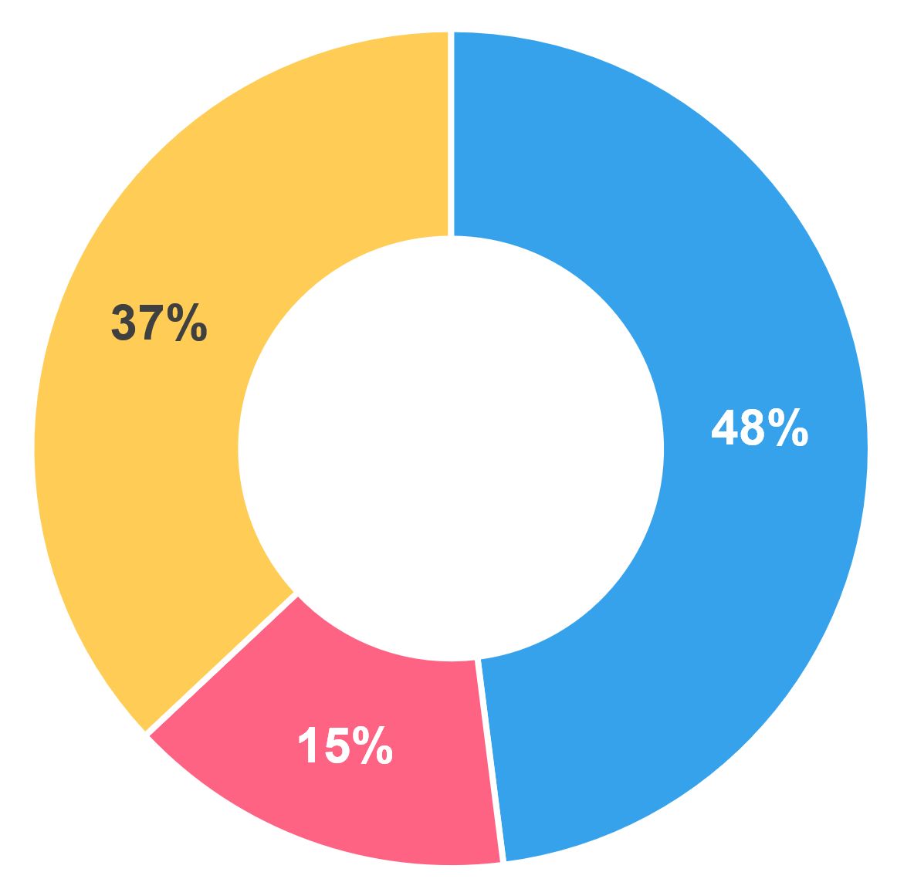
 | 1Q | 2Q | 3Q | 4Q | 1Q | 2Q | 3Q | 4Q | 1Q | 2Q | 3Q | 4Q | 1Q | 2Q | 3Q | 4Q | 1Q | 2Q | 3Q | 4Q
Direct | 76% | 60% | 45% | 61% | 62% | 69% | 66% | 53% | 55% | 62% | 49% | 47% | 51% | 51% | 55% | 63% | 50% | 44% | 49% | 61%
Mail | 1% | 1% | 1% | 1% | 0% | 2% | 2% | 2% | 3% | 3% | 4% | 3% | 3% | 2% | 2% | 3% | 2% | 3% | 3% | 4%
Referral | 1% | 7% | 11% | 9% | 7% | 8% | 11% | 14% | 16% | 6% | 12% | 16% | 6% | 5% | 6% | 5% | 5% | 5% | 6% | 5%
Organic Search | 19% | 24% | 27% | 22% | 26% | 16% | 15% | 22% | 18% | 20% | 25% | 25% | 39% | 39% | 34% | 26% | 40% | 43% | 39% | 27%
Organic Social | 1% | 1% | 1% | 1% | 0% | 1% | 1% | 1% | 1% | 1% | 1% | 1% | 1% | 1% | 0% | 0% | 1% | 1% | 1% | 0%
HQ Traffic | 98% | 93% | 86% | 94% | 96% | 96% | 96% | 93% | 92% | 92% | 90% | 93% | 99% | 98% | 97% | 97% | 98% | 97% | 98% | 97%
Paid Search | 1% | 4% | 6% | 3% | 1% | 1% | 1% | 2% | 2% | 3% | 6% | 4% | 1% | 1% | 3% | 1% | 2% | 3% | 2% | 3%
Paid Social | 0% | 0% | 0% | 0% | 0% | 0% | 0% | 1% | 0% | 1% | 0% | 0% | 0% | 0% | 0% | 1% | 0% | 0% | 0% | 0%
Display Ad | 0% | 3% | 8% | 3% | 3% | 3% | 3% | 4% | 5% | 4% | 3% | 2% | 0% | 0% | -- | -- | 0% | 0% | 0% | 0%
Other | -- | -- | -- | -- | -- | -- | -- | -- | -- | -- | -- | -- | -- | -- | -- | -- | -- | -- | -- | --
Total Traffic | 100% | 100% | 100% | 100% | 100% | 100% | 100% | 100% | 100% | 100% | 100% | 100% | 100% | 100% | 100% | 100% | 100% | 100% | 100% | 100%
2019
2020
2021
2022
2023

Slide 6
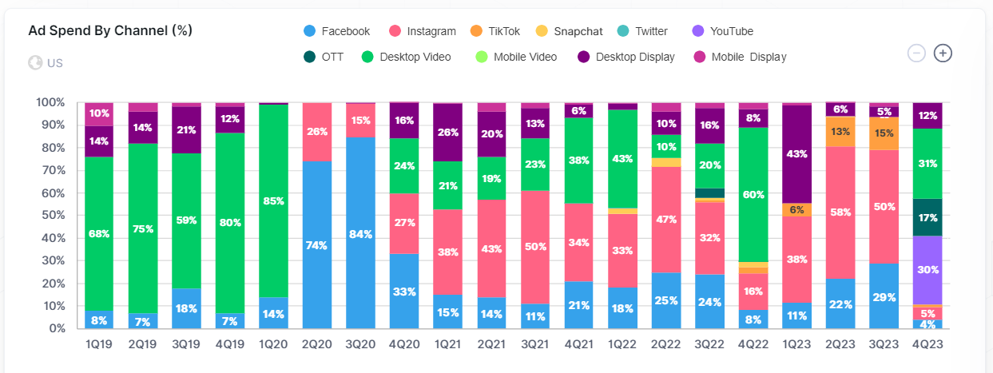
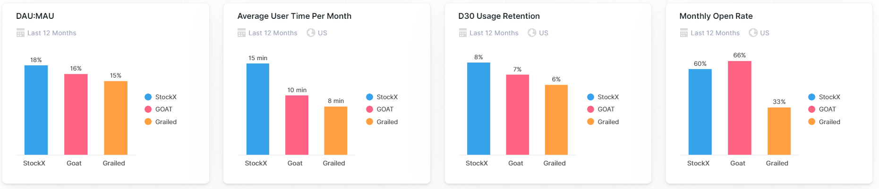
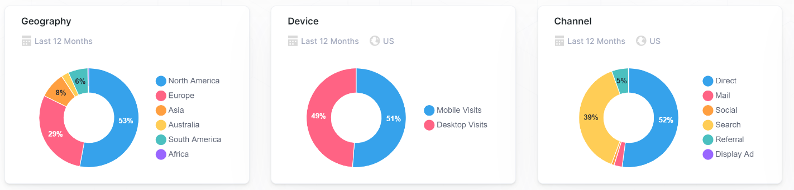
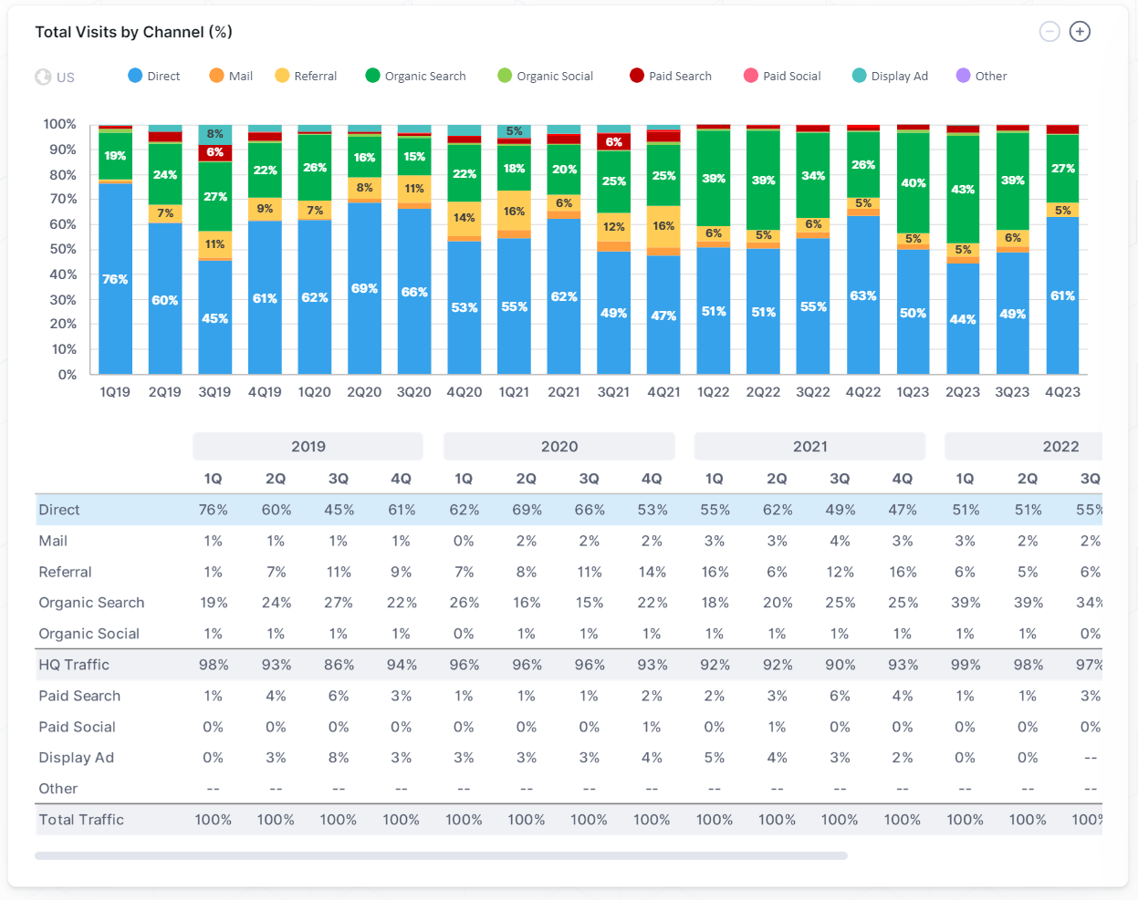
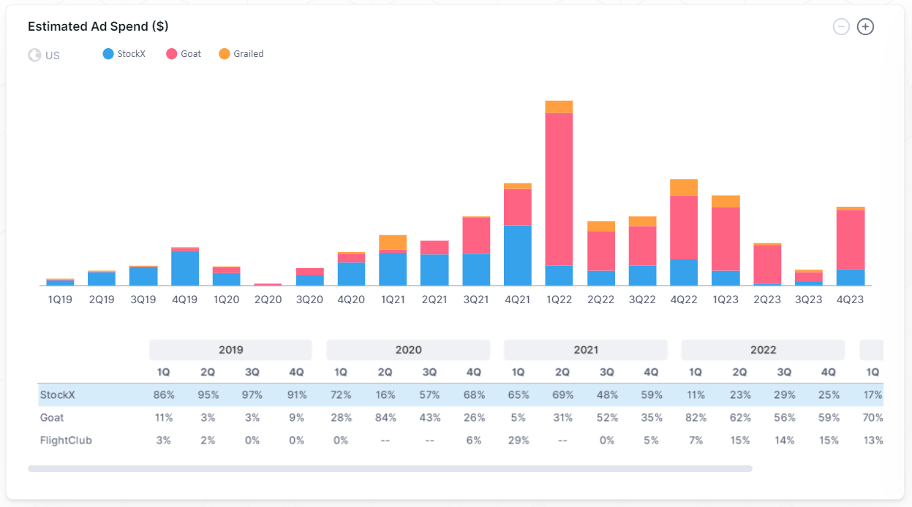
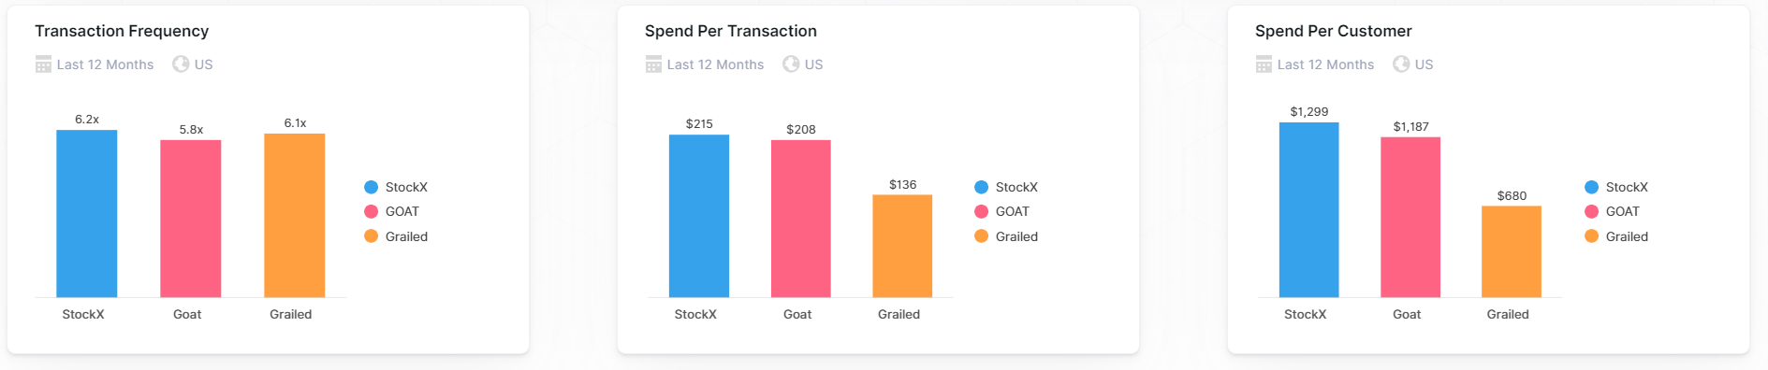

Slide 7


Slide 8
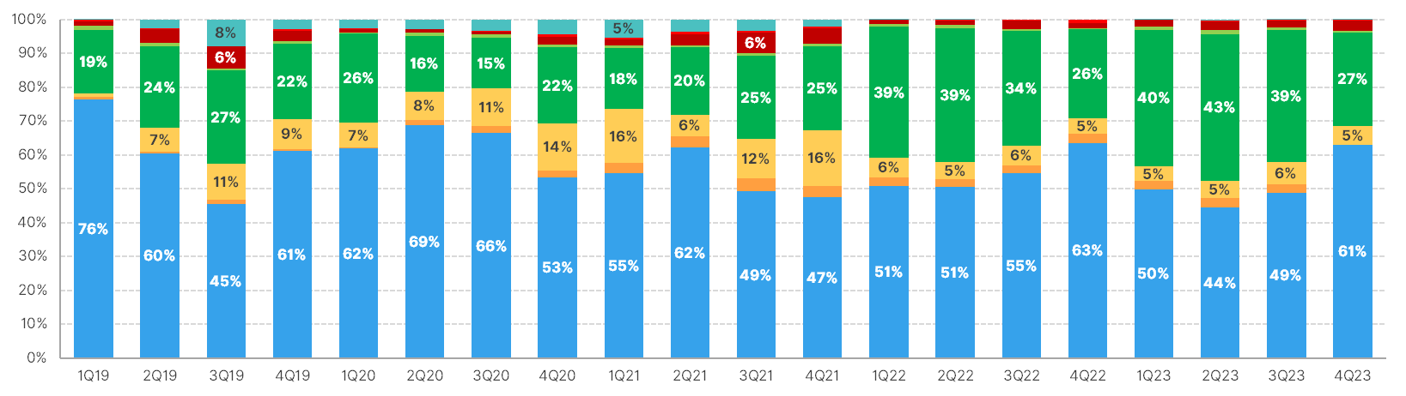
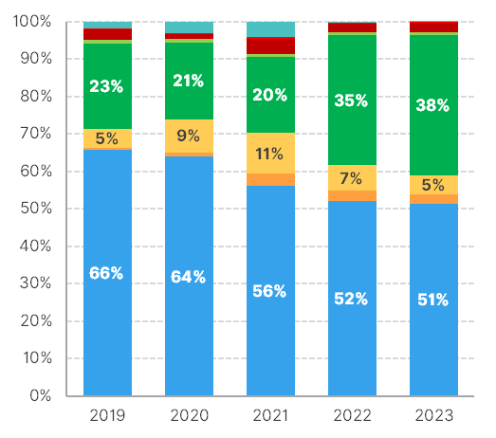
 | 1Q | 2Q | 3Q | 4Q | 1Q | 2Q | 3Q | 4Q | 1Q | 2Q | 3Q | 4Q | 1Q | 2Q | 3Q | 4Q | 1Q | 2Q | 3Q | 4Q
Direct | 76% | 60% | 45% | 61% | 62% | 69% | 66% | 53% | 55% | 62% | 49% | 47% | 51% | 51% | 55% | 63% | 50% | 44% | 49% | 61%
Mail | 1% | 1% | 1% | 1% | 0% | 2% | 2% | 2% | 3% | 3% | 4% | 3% | 3% | 2% | 2% | 3% | 2% | 3% | 3% | 4%
Referral | 1% | 7% | 11% | 9% | 7% | 8% | 11% | 14% | 16% | 6% | 12% | 16% | 6% | 5% | 6% | 5% | 5% | 5% | 6% | 5%
Organic Search | 19% | 24% | 27% | 22% | 26% | 16% | 15% | 22% | 18% | 20% | 25% | 25% | 39% | 39% | 34% | 26% | 40% | 43% | 39% | 27%
Organic Social | 1% | 1% | 1% | 1% | 0% | 1% | 1% | 1% | 1% | 1% | 1% | 1% | 1% | 1% | 0% | 0% | 1% | 1% | 1% | 0%
HQ Traffic | 98% | 93% | 86% | 94% | 96% | 96% | 96% | 93% | 92% | 92% | 90% | 93% | 99% | 98% | 97% | 97% | 98% | 97% | 98% | 97%
Paid Search | 1% | 4% | 6% | 3% | 1% | 1% | 1% | 2% | 2% | 3% | 6% | 4% | 1% | 1% | 3% | 1% | 2% | 3% | 2% | 3%
Paid Social | 0% | 0% | 0% | 0% | 0% | 0% | 0% | 1% | 0% | 1% | 0% | 0% | 0% | 0% | 0% | 1% | 0% | 0% | 0% | 0%
Display Ad | 0% | 3% | 8% | 3% | 3% | 3% | 3% | 4% | 5% | 4% | 3% | 2% | 0% | 0% | -- | -- | 0% | 0% | 0% | 0%
Other | -- | -- | -- | -- | -- | -- | -- | -- | -- | -- | -- | -- | -- | -- | -- | -- | -- | -- | -- | --
Total Traffic | 100% | 100% | 100% | 100% | 100% | 100% | 100% | 100% | 100% | 100% | 100% | 100% | 100% | 100% | 100% | 100% | 100% | 100% | 100% | 100%
Visits Breakdown
Direct
Mail
Referral
Organic Search
Organic Social
Paid Search
Paid Social
Display Ad
Other
Quarterly
Annual
2019
2020
2021
2022
2023

Slide 9
 | 1Q | 2Q | 3Q | 4Q | 1Q | 2Q | 3Q | 4Q | 1Q | 2Q | 3Q | 4Q | 1Q | 2Q | 3Q | 4Q | 1Q | 2Q | 3Q | 4Q
Direct | 76% | 60% | 45% | 61% | 62% | 69% | 66% | 53% | 55% | 62% | 49% | 47% | 51% | 51% | 55% | 63% | 50% | 44% | 49% | 61%
Mail | 1% | 1% | 1% | 1% | 0% | 2% | 2% | 2% | 3% | 3% | 4% | 3% | 3% | 2% | 2% | 3% | 2% | 3% | 3% | 4%
Referral | 1% | 7% | 11% | 9% | 7% | 8% | 11% | 14% | 16% | 6% | 12% | 16% | 6% | 5% | 6% | 5% | 5% | 5% | 6% | 5%
Organic Search | 19% | 24% | 27% | 22% | 26% | 16% | 15% | 22% | 18% | 20% | 25% | 25% | 39% | 39% | 34% | 26% | 40% | 43% | 39% | 27%
Organic Social | 1% | 1% | 1% | 1% | 0% | 1% | 1% | 1% | 1% | 1% | 1% | 1% | 1% | 1% | 0% | 0% | 1% | 1% | 1% | 0%
HQ Traffic | 98% | 93% | 86% | 94% | 96% | 96% | 96% | 93% | 92% | 92% | 90% | 93% | 99% | 98% | 97% | 97% | 98% | 97% | 98% | 97%
Paid Search | 1% | 4% | 6% | 3% | 1% | 1% | 1% | 2% | 2% | 3% | 6% | 4% | 1% | 1% | 3% | 1% | 2% | 3% | 2% | 3%
Paid Social | 0% | 0% | 0% | 0% | 0% | 0% | 0% | 1% | 0% | 1% | 0% | 0% | 0% | 0% | 0% | 1% | 0% | 0% | 0% | 0%
Display Ad | 0% | 3% | 8% | 3% | 3% | 3% | 3% | 4% | 5% | 4% | 3% | 2% | 0% | 0% | -- | -- | 0% | 0% | 0% | 0%
Other | -- | -- | -- | -- | -- | -- | -- | -- | -- | -- | -- | -- | -- | -- | -- | -- | -- | -- | -- | --
Total Traffic | 100% | 100% | 100% | 100% | 100% | 100% | 100% | 100% | 100% | 100% | 100% | 100% | 100% | 100% | 100% | 100% | 100% | 100% | 100% | 100%
Visits Breakdown
Direct
Mail
Referral
Organic Search
Organic Social
Paid Search
Paid Social
Display Ad
Other
Quarterly
Annual
2019
2020
2021
2022
2023

Slide 10
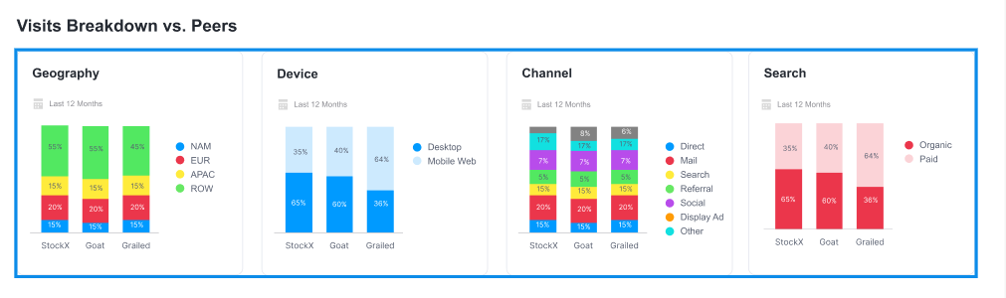
Visits Breakdown
Geo
Last 12 Months Visits (Worldwide)
Device
Last 12 Months Visits (US)
Channel
Last 12 Months Visits (US)
Direct
North America
Desktop
Mail
Europe
Mobile Web
Referral
Asia
Organic Search
Australia
Organic Social
South America
Paid Search
Africa
Paid Social
Display Ad
Other
Organic vs. Paid
Last 12 Months Visits (US)
Figma Reference
Organic Search
Organic Social
Paid Search
Paid Social

Slide 11
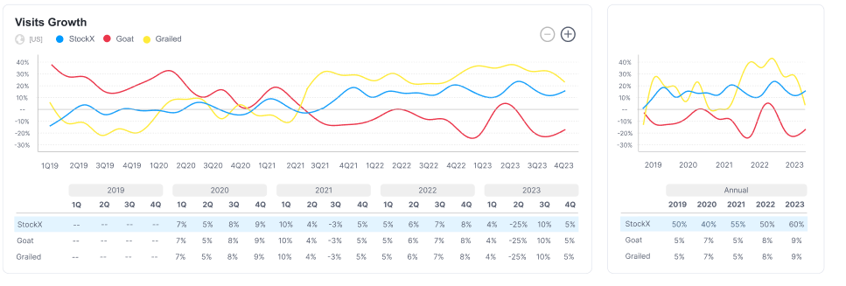
Visits Growth
StockX
Goat
Grailed
Quarterly
Annual
Figma Reference

Slide 12
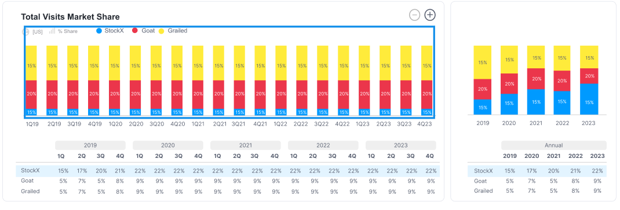
Visits Market Share
StockX
Goat
Grailed
Quarterly
Annual
Figma Reference

Slide 13
HEADCOUNT
StockX
Quarterly Headcount
StockX
Annual Headcount

Slide 14
